Slide 1
Priority Queue & Circular Linked List
Data Structures
Ashwin Muthu Kumar S
1831007

Slide 2
Priority Queue
Priority Queue is an extension of queue with following properties.
Every item has a priority associated with it.
An element with high priority is dequeued before an element with low priority.
If two elements have the same priority, they are served according to their order in the queue.

Slide 3
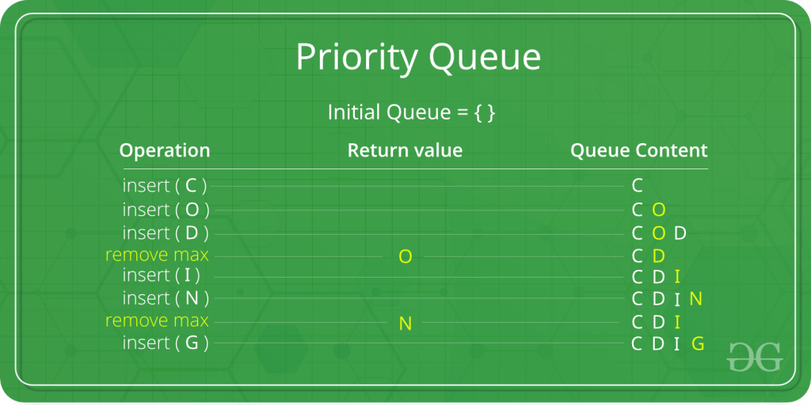
EXAMPLE
In the below priority queue, element with maximum ASCII value will have the highest priority.

Slide 4
Priority Queue
A typical priority queue supports following operations.
insert(item, priority): Inserts an item with given priority.
getHighestPriority(): Returns the highest priority item.
deleteHighestPriority(): Removes the highest priority item.

Slide 5
How to implement priority queue?
Using Array
A simple implementation is to use array of following structure.
struct item {
int item;
int priority;
}

Slide 6
insert() operation can be implemented by adding an item at end of array in O(1) time.
getHighestPriority() operation can be implemented by linearly searching the highest priority item in array. This operation takes O(n) time.
deleteHighestPriority() operation can be implemented by first linearly searching an item, then removing the item by moving all subsequent items one position back.
We can also use Linked List, time complexity of all operations with linked list remains same as array. The advantage with linked list is deleteHighestPriority() can be more efficient as we don’t have to move items.

Slide 7
Using Heaps
Heap is generally preferred for priority queue implementation because heaps provide better performance compared arrays or linked list.
In a Binary Heap,
getHighestPriority() can be implemented in O(1) time,
insert() can be implemented in O(Logn) time and
deleteHighestPriority() can also be implemented in O(Logn) time.
With Fibonacci heap,
insert() and getHighestPriority() can be implemented in O(1) amortized time and
deleteHighestPriority() can be implemented in O(Logn) amortized time.

Slide 8
Circular Linked List
Circular Linked List is a variation of Linked list in which the first element points to the last element and the last element points to the first element. Both Singly Linked List and Doubly Linked List can be made into a circular linked list.

Slide 9

Singly Linked List as Circular
In singly linked list, the next pointer of the last node points to the first node.

Slide 10

Doubly Linked List as Circular
In doubly linked list, the next pointer of the last node points to the first node and the previous pointer of the first node points to the last node making the circular in both directions.

Slide 11
IMPORTANT POINTS
The last link's next points to the first link of the list in both cases of singly as well as doubly linked list.
The first link's previous points to the last of the list in case of doubly linked list.

Slide 12
Basic Operations
Following are the important operations supported by a circular list.
insert − Inserts an element at the start of the list.
delete − Deletes an element from the start of the list.
display − Displays the list.

Slide 13
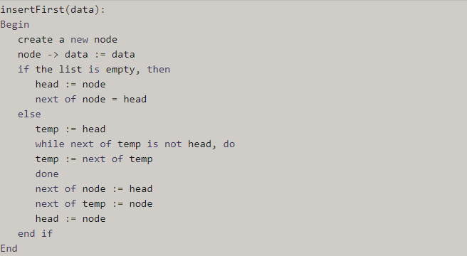
1. Insertion Operation

Slide 14
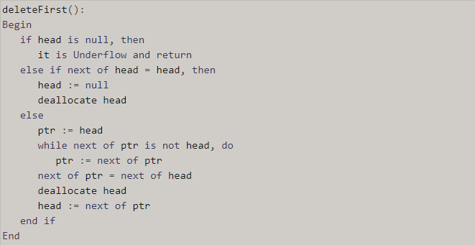
2. Deletion Operation

Slide 15
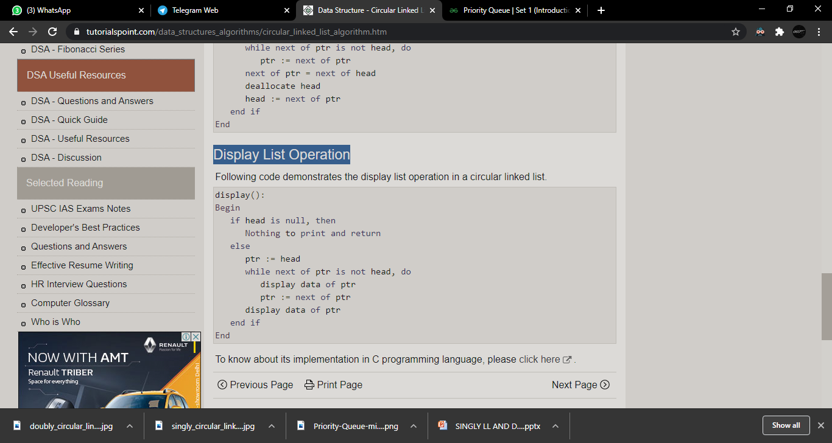
3. Display List Operation

Slide 16
THANK YOU

